Slide 1
Pre-Live Session 1
Stationarity

Slide 2
House Appliances energy Data Set
The data set is at 10 min for about 4.5 months. Data has 19735 rows.
The house temperature and humidity conditions were monitored and measured every 3.3 min.
Then, the data was averaged for 10 minutes periods.
The energy data was logged every 10 minutes with m-bus energy meters.
Weather from the nearest airport weather station (Chievres Airport, Belgium) was also collected.

Slide 3
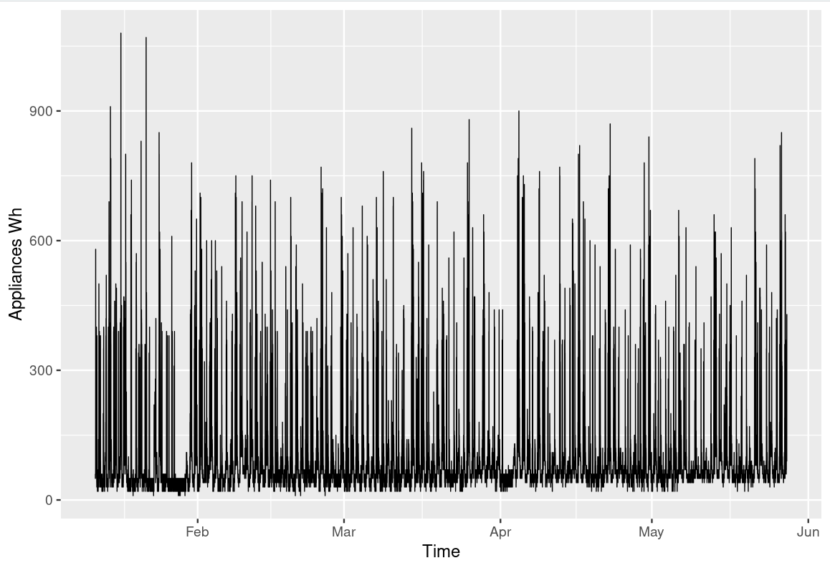
House Appliance in Wh

Slide 4
House Appliance Dataset Contd..
Additional Realization
Because of the conditions of the measurements, future realizations could be measured. Also, there might be problems with replicating similar environments if the environment used is changed or isn’t available. There can be additional realization.
Condition 1
The mean of the dataset is uniform and constant. There are pockets of lows and highs but we can assume that if we have more realizations the value would come down. So we will assume that the mean does not depend on time.
Condition 2
If we assume a constant variance for the distribution temperature T1, we can use all data to estimate the common variance. This condition was met because we assume that the values are from a normal distribution.

Slide 5
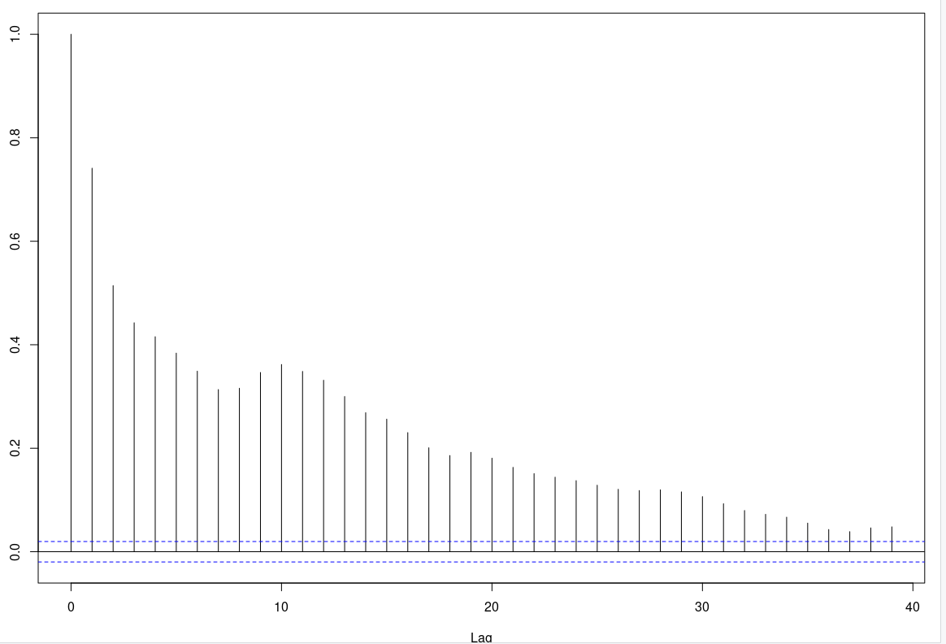
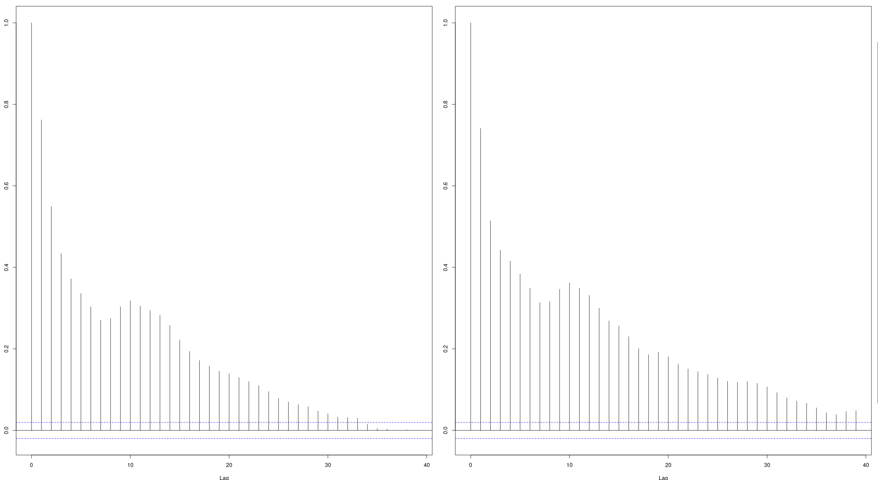
Condition 3
The original plot shows a bit of serial independence in some cases. There isn’t a wide margin in range between different clusters of points so there could be instances where xt and xt+1could be on different sides of the mean(upper and lower). It could also be that we have lots of points that the plot doesn’t give us a better understanding where the points are.
However, looking at the ACF plots we can conclude that there is evidence of a strong autocorrelation between xt and xt+1.

Slide 6
Takeaways
If we assume that the values are normally distributed, than there should be a constant variance
ACF plots can tell us if there is a strong autocorrelation between xt and xt+1.
If we assume a constant mean across all time, it is reasonable to use all the data to estimate the common mean.
Two events are said to be independent if the probability that one event occurs in on way depends on the occurrence of the other event.
Mean and variance does not depend on time for stationary to be true.
The correlation of xt and xt+1 depends on how far apart they are in time.

